Slide 1

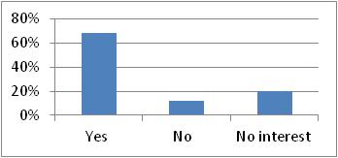
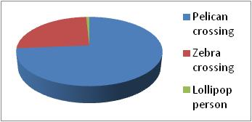
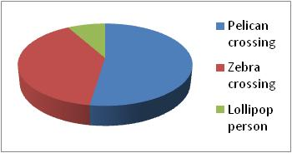
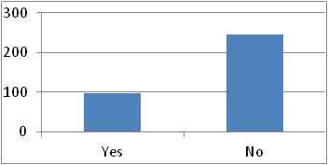
Tiddington 4 Village Plan
Survey Results – Roads
Two thirds of respondents wanted a controlled crossing of the A418 in Tiddington, with the very large majority preferring a pelican crossing
A majority of respondents were willing to help raise funds for a crossing, especially a pelican crossing, but respondents were also clearly unsupportive of an increase in local taxes to pay for the crossing

Slide 2
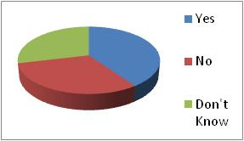
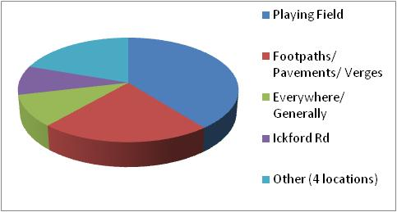
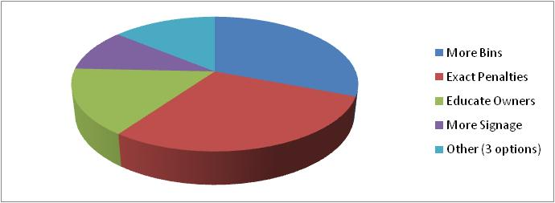
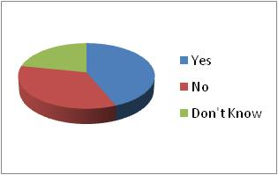
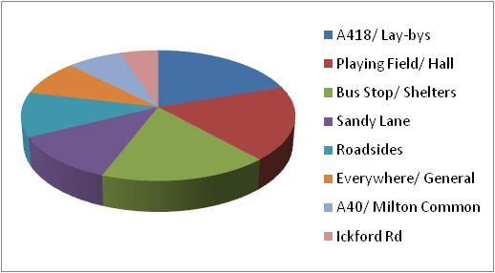
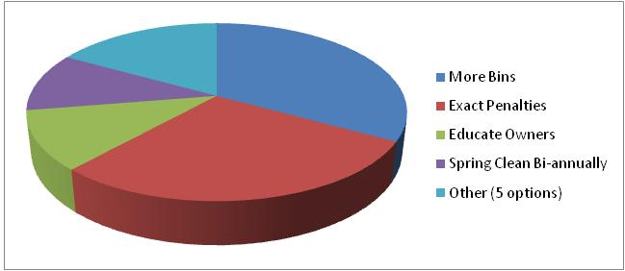
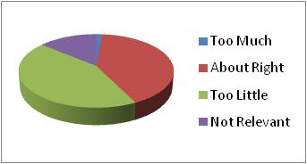
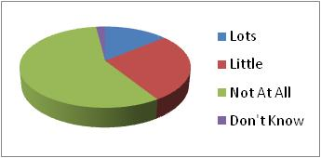
Tiddington 4 Village Plan
Survey Results – Environment
Dog Fouling - 40% of respondents think it a problem
In particular on the playing field and footpaths/ pavements/ verges
Preferred solutions – more bins & exacting penalties
Littering- 44% of respondents think it a problem
In particular along the A418/ lay-bys, playing field/ hall and bus stops & shelters
Preferred solutions – more bins & exacting penalties
Street Lighting - Almost equal split between too little and about right level
Noise - Only 14% of responses said affected “Lots” –main culprits are air & road traffic

Slide 3
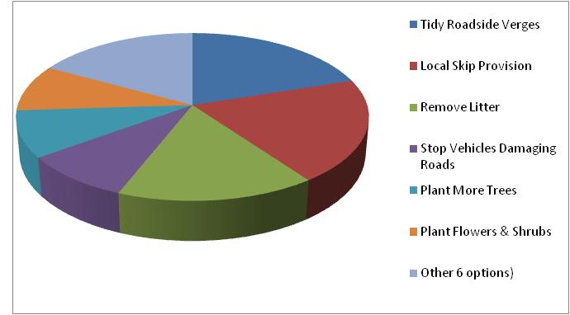
Tiddington 4 Village Plan
Survey Results – Environment
Most beneficial measures, of those suggested, were seen as tidying roadside verges, provision of a local skip and removing litter
Results shown are for first choices – results for all choices broadly similar

Slide 4
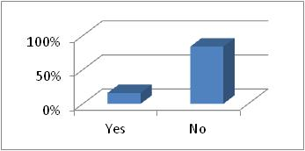
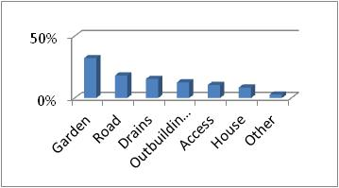
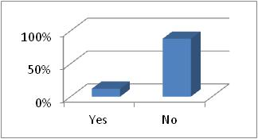
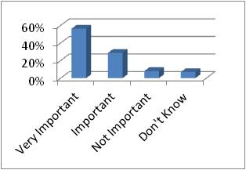
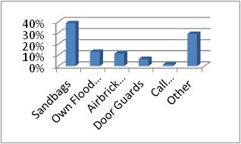
Tiddington 4 Village Plan
Survey Results – Flooding
86% of respondents have not suffered flooding here
50% of floods were of gardens and roads
88% of respondents have not taken their own steps to prevent flooding
85% of respondents think it important or very important the council takes action to prevent flooding
Sandbags are the most common form of self-protection

Slide 5
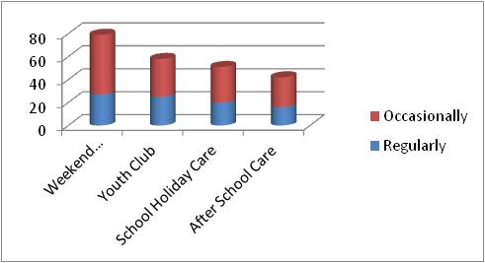
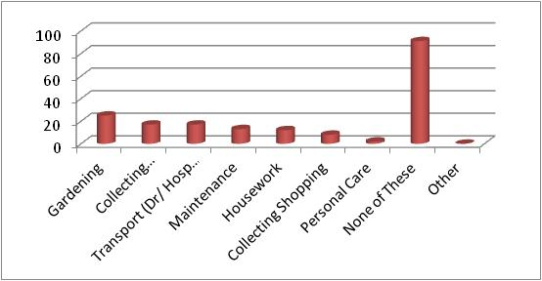
Tiddington 4 Village Plan
Survey Results – Supporting Services
All 4 suggested activities to support children and adolescents received more than 40 expressions of interest in at least occasional use, with weekend activities for children attracting most interest
Most elderly people or those with a disability or mobility problem wanted no support, but there were more than 15 expressions of interest for each of gardening, collecting prescriptions and transport to hospital or GP.

Slide 6
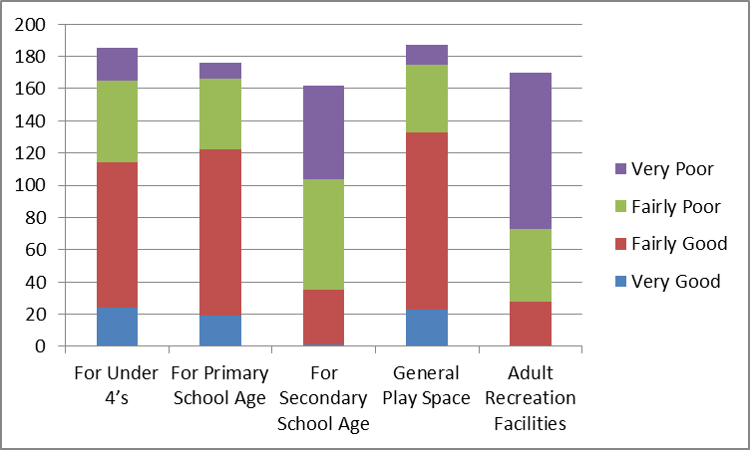
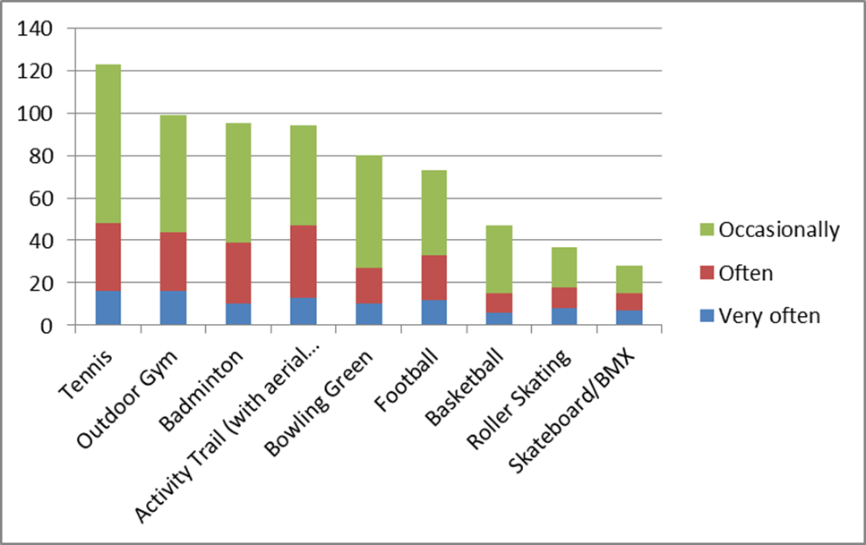
Tiddington 4 Village Plan
Survey Results – Leisure
How do you rate the current play
equipment in Tiddington?
How often would you use the following
facilities if provided in Tiddington?
Play equipment for children and the
quality of the General Play Space
was perceived to be “Good”.
Facilities for Secondary School Age
and Adults was perceived to be “Poor”
Tennis would be the most popular activity overall
Activity Trail was, however, more popular when
counting only responses of “Very often” & “Often”.

Slide 7
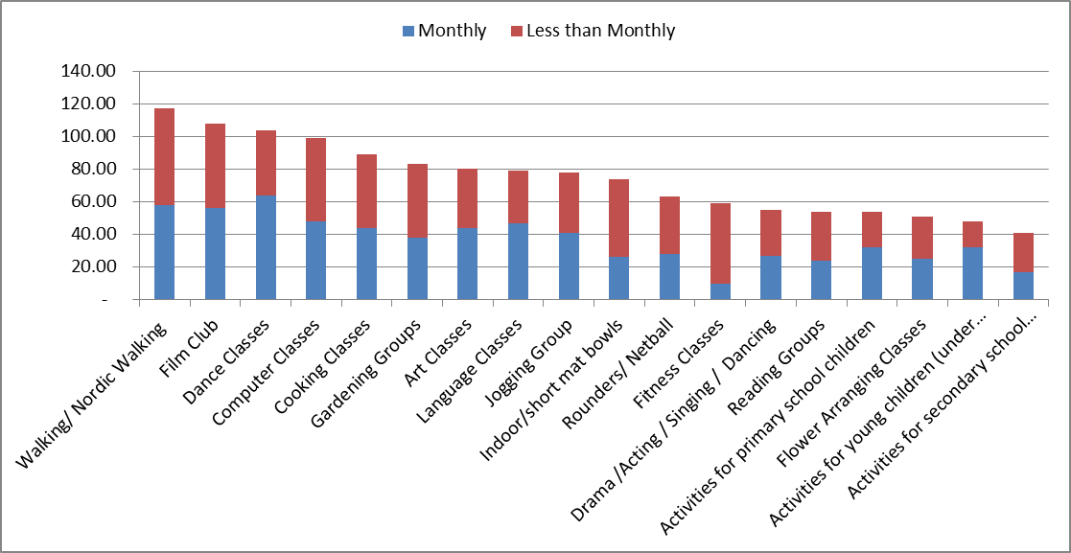
Tiddington 4 Village Plan
Survey Results – Leisure
The most popular activities, counting only those who would use them monthly, were
Dance Classes, Walking/ Nordic Walking and Film Club with over 50 potential users each

Slide 8
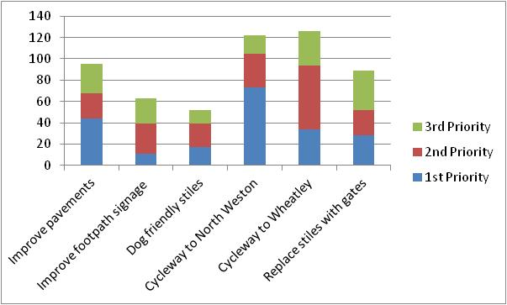
Tiddington 4 Village Plan
Survey Results – Leisure
Provision of cycleways was given highest priority by respondents, when counting both first priorities only and all priorities

Slide 9
Tiddington 4 Village Plan
Survey Results – Housing
Would you potentially support / accept housing development in the parish if plans were put to the council?
189 out of 353 respondents would support limited development
97 respondents favour no more development

Slide 10
Tiddington 4 Village Plan
Survey Results – Housing
If the parish does have new development, which types of housing do you believe are most important for the parish?
Most Important Housing Type – Housing for people with local connections only
Least Important Housing Type – Affordable Housing to buy / Shared Ownership

Slide 11
Tiddington 4 Village Plan
Survey Results – Housing
OTHER TYPES OF HOUSING:
- First time buyers - Housing only in villages with existing amenities i.e. Great Milton
- Private market housing - Housing suitable for the elderly should be for their use only
- Possibly small bungalows for old people - Affordable housing and larger properties. Good to have a mix of home owners/occupiers across village
- Single dwellings for senior villagers to relocate to when house/garden gets to big/much - This is a mixed community and this should guide any future development
- Wardened or community housing for the elderly
*******************************
Do you think preference for low-cost homes (shared equity, public social rented) should be given to people who have an existing family or other close connection with the parish?
84% Yes
16% No
*******************************

Slide 12
Tiddington 4 Village Plan
Survey Results – Housing
If development were to take place what would you be concerned about……? Most Concerned About – The Size of the Development & Increased Traffic Least Concerned About – Sub Division of Gardens & Infilling Between Properties

Slide 13
Tiddington 4 Village Plan
Survey Results – Broadband
A large majority of respondents have broadband but want faster connectivity.
However only roughly one third would pay more than £10 monthly for increased speed.

Slide 14
Tiddington 4 Village Plan
Survey Results – Broadband
The broadband speeds are significantly higher in Tiddington (Ickford exchange)
compared to the rest of the parish although less than only one quarter of all
Broadband users have speeds greater than 4Mbps – The national average is 9Mbps

Slide 15
Tiddington 4 Village Plan
Survey Results – Broadband
5 types of service would be accessed more frequently by more than
30% of respondents if faster broadband speeds were available locally

Slide 16
Tiddington 4 Village Plan
Survey Results - Economic Development
Most respondents viewed the provision of additional business premises positively
whilst expressing concerns about the impact of additional traffic and possible growth
of the built-up area
320 responses
86% of respondents
60% of total
Other : Parking, noise, rural area

Slide 17
Tiddington 4 Village Plan
Survey Results - Economic Development
More than 140 respondents work at home at least occasionally, of whom
more than 60 own or part own their business and thirty-one would be
interested in a local networking event
338 responses
91% of respondents
64% of total
(31)

Slide 18
Tiddington 4 Village Plan
Survey Results - Crime & Policing
37 written responses about community safety were received, with the biggest
issues of concern being speeding (9 responses) and drug dealing (6). Seven
other issues received 5 or less responses each.

Slide 19
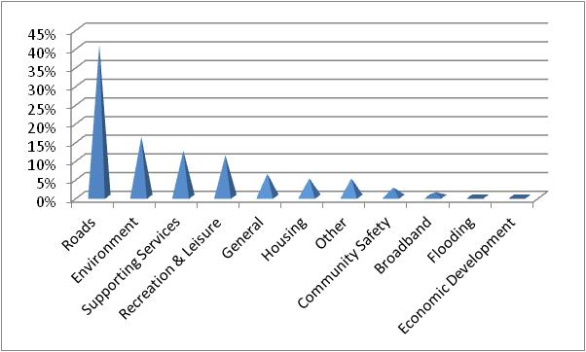
Tiddington 4 Village Plan
Survey Results – General Comments
40% of general comments concerned roads with speeding, vibration and noise (especially on the A 418) being the predominant subject with 18 comments, followed by provision of the crossing in Tiddington with 5 comments. The need for a shop (6 comments) and for affordable housing (4 comments) were the next subjects of most concern generally.
Total comments = 81

